Slide 1
Design
Information Architecture
Web - 13”/ Mob - 4.7” + [ TCD or and UCD ] + UX Assets (User Research)
Objective Evidence [User Research] or Subjective Evidence / Objective Evidence / Objective Evidence and Subjective Evidence

Slide 2
UXD Pillars
Information Architecture (IA)
Interaction Design (IXD)
Content Design (CD)
Navigation Design (ND)

Slide 3

The world is complex
• People face more choices and avenues
• Businesses are under more pressure
• Technology is advanced, but constantly changing
• We are all personally experiencing
information overload
3

Slide 4
Information is not found, it is Communicated
Data
Information
Knowledge
Wisdom

Slide 5
Information is not found, it is Communicated
Data
Information
Knowledge
Wisdom
• Research
• Presentation
• Conversation
• Contemplation
• Creation
• Organization
• Storytelling
• Evaluation
• Gathering
• Integration
• Interpretation
• Discovery

Slide 6
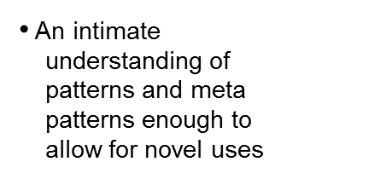
How people understand
Data
Information
Knowledge
Wisdom
• Contextless
• The careful
• Gained through
• Exhaustive, not curated
arrangement
experience with
of data to
the same set of
• Not meant to inform the
perform in a
data from a variety
context
of perspectives
consumer

Slide 7
Some (of many) Enemies of Understanding
• Familiarity: Being too close to the problem can make you forget to remember what it is like to NOT understand
• Looking good vs. being good: Tricking yourself into thinking something is good because it is good looking
• “Uh, Huh”: Not admitting ignorance when faced with it
• Unnecessary Exactitude: Including more detail than is helpful
• Rainbow Worship: Believing that more color or colorful flowery language is always better
• Edifitis: Belief that a better, shinier “such and such” could and will fix the problem
• Not asking Why: Simple as that. Always ask why.
• How before What: Thinking to specifically about solutions before the problem is defined
7

Slide 8
What HAppens without understanding?
8

Slide 9
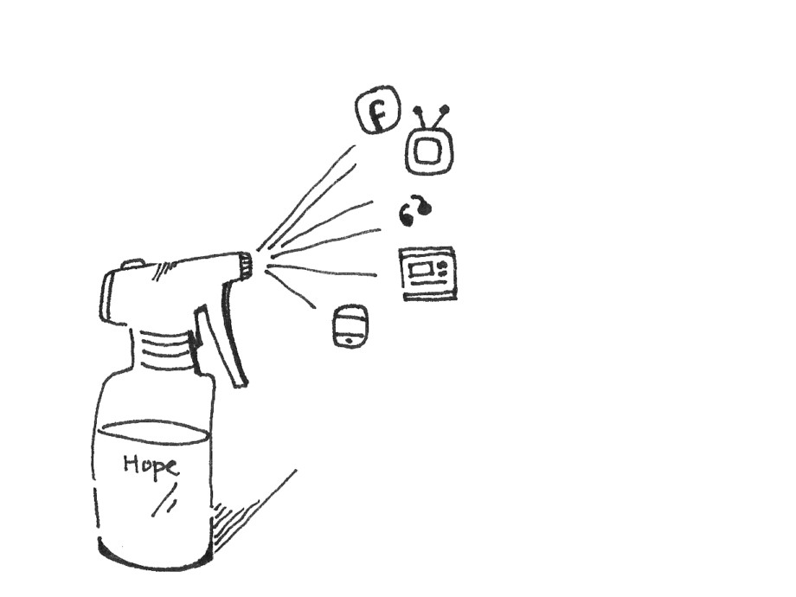
Spray-n-Pray is common wisdom
9

Slide 10
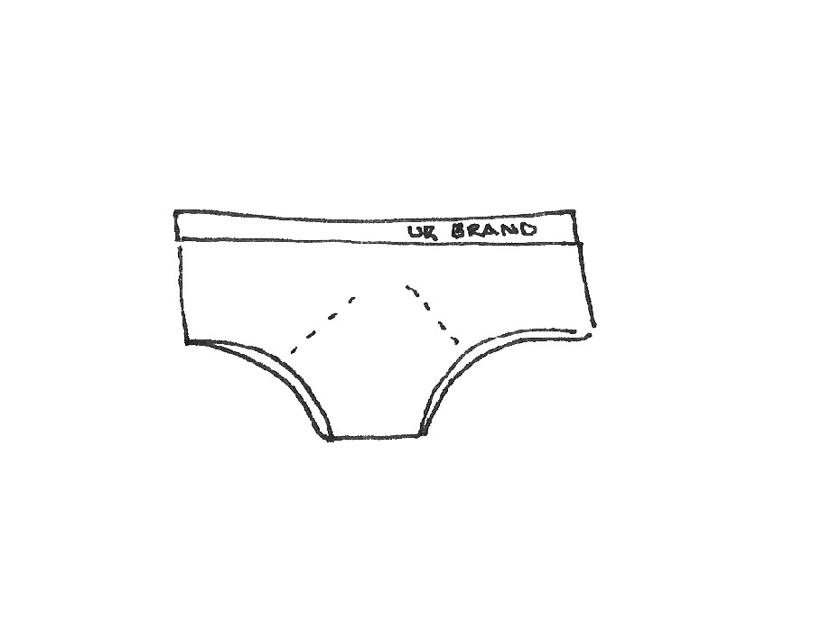
Corporate Underpants start to show
10

Slide 11

Shiny, dusty objects accumulate
11

Slide 12
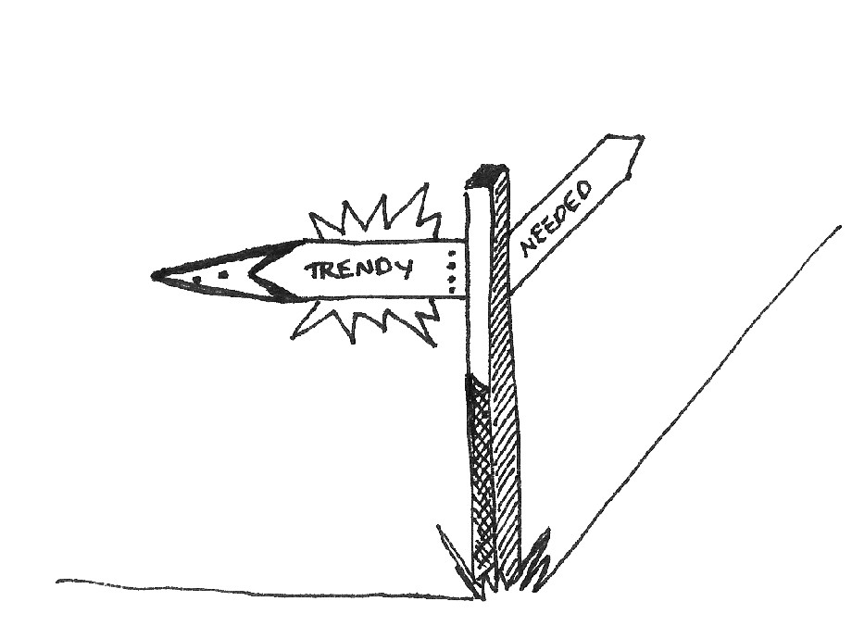
Trends win out over needs

Slide 13
Information
Architects to the rescue...
13

Slide 14

I am an
information architect
I intend to
because I believe everything is complex
make the unclear clear
put the what before the how
architecture frames problems, design solves them
facilitate understanding organize meaning,
understanding is always good but it is equally important to not understand
create clarity and establish truth
support goals, makers and users
clarity is a prerequisite of truth
by: Abby Covert & Dan Klyn
14

Slide 15
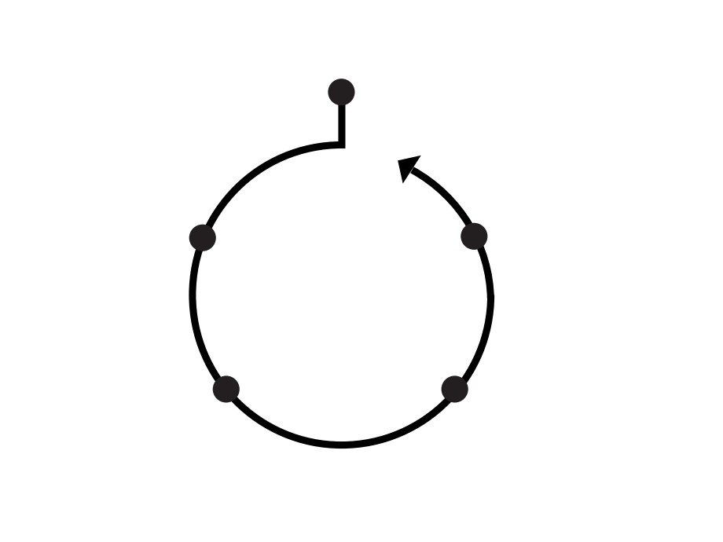
Why we need Change?
Stakeholder Interviews Competitive Research Heuristic Evaluation Existing User Research
What Are
How will we do this?
we doing?
Touchpoint Mapping Workshop User Segmentation Workshop
tools I use +
Wireframes and Prototypes Functional Specifications Content Inventory
questions I help Answer
Goal Setting Workshop Experience Brief
Who to
When Are we Doing what?
Consider?
User Research Persona Development
Flow, Maps and Roadmaps Scoping Workshop
Collaborative Design Session
15

Slide 16
Context?
IA
Content?
Users?

Slide 17
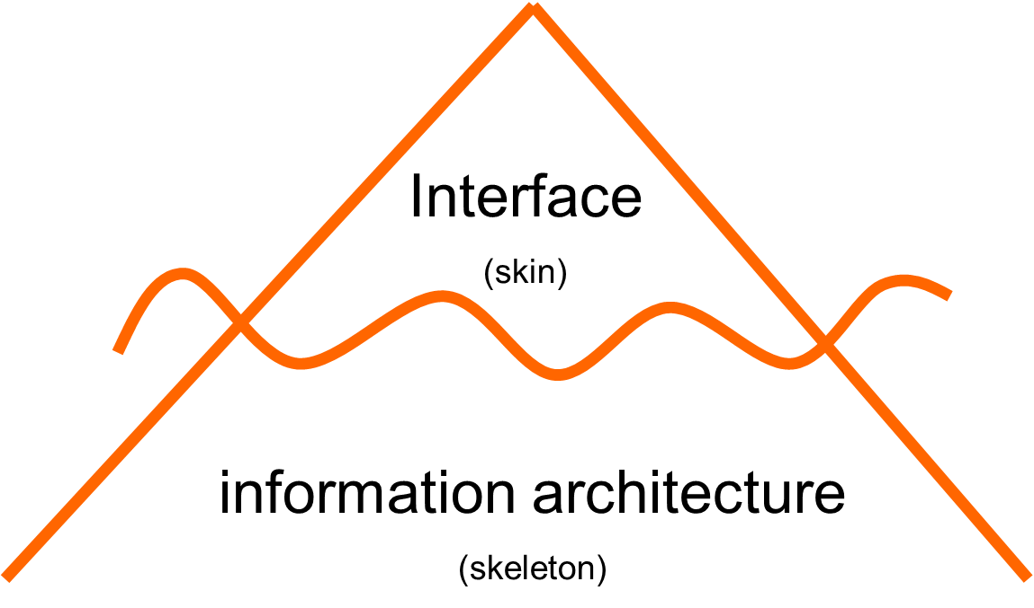

Slide 18
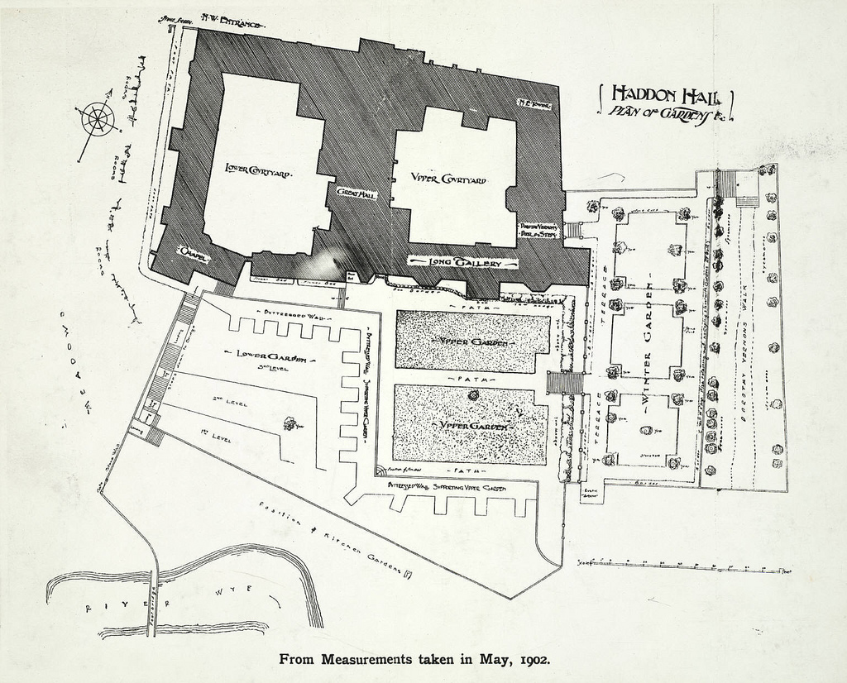
Design Process
metaphor: architectural plans
Notes:
Using architectural plans/blueprints as a metaphor for an IA’s work

Slide 19
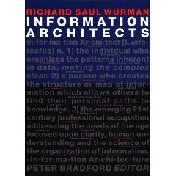

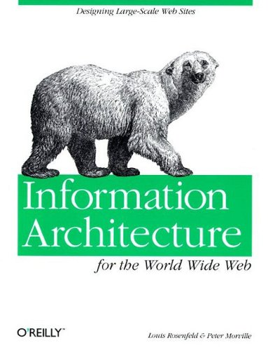
A Brief History of IA
1975
Richard Saul Wurman coined the term “information architecture” to describe the field now more likely described as “information design”
1994
Formation of Argus Associates in Ann Arbor, WI, the first firm devoted to IA
1998
First edition of Peter Morville and Lou Rosenfeld’s Information Architecture for the World Wide Web, affectionately known as “The Polar Bear” book

Slide 20



A Brief History of IA
2000
First IA Summit, Boston, MA – Defining Information Architecture
2002
Boxes & Arrows, online journal for information architects goes live
3 new books on IA published, including Jesse James Garrett’s The Elements of User Experience
2014
15th Annual IA Summit held in San Diego, CA, March 25-30
Notes:
Partially adapted from: “A brief history of information architecture” by Peter Morville
Information Architecture: Designing information environments for purpose, edited by Alan Gilchrist and Barry Mahon

Slide 24
Before any IA

Slide 25
Information Architecture
IA is the art of expressing a model or concept of information used in activities that require explicit details of complex systems
IA is the structural integrity of meaning across contexts
IA should be practically defined through the balance the needs and goals of business or site and intended audience to deliver a roadmap on how information should be presented on:
Content
Navigation
Labelling

Slide 27
Good AI requires
Understanding business needs/goals
Understanding user needs/goals -?- IXD
Organising information so it makes sense?
Create a structure to support information, content and users/business needs.

Slide 28
Structure, Organisation and Taxonomy
OST in AI is not only important for storing and displaying information and content, but also critical for information retrieval.
Organisation provides a front end supportive means of visually and textually displaying and delivering information and content.
Structure and taxonomy provides backend supportive mechanism for data retrieval and works hand in hand with mainstream digital marketing activities such as SEO.

Slide 29
In the next hour ….
Examine and analyse the Structure (Regional Structure)
Examine and analyse the Organisation of Information (in each region).
Examine and analyse the Taxonomy of information.

Slide 30
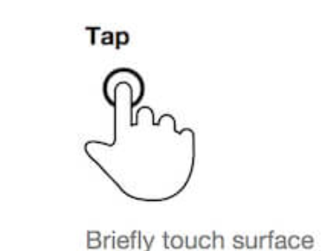
Needs
Needs
Needs

